Slide 1
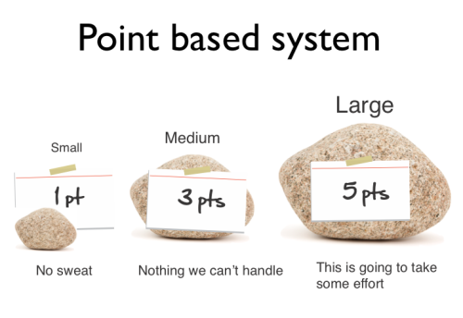

Agile Estimation
CSSE579
Session 4
Part 1
Note: Additional questions from the reading quiz – Start on slide 17
Notes:
Based on the ThoughtWorks reading – On Moodle, and on the course website (under Resources).
A typical point system, as shown above, only tries to estimate the work generally, not precisely.
Agile estimation method illustration, from http://agilewarrior.wordpress.com/2013/05/29/new-agile-estimation-video/

Slide 2
Week 4’s plan
Jared Goulding is here to discuss our masters program.
  And I can propose a summer course – Software Architecture!
Exam 1 – Still owe you the key for the objective part.
Project/presentation feedback from each person – about project planning.
Project planning – requirements, cntd
  Week 3, slide set 4 - Agile requirements – Highsmith’s view – we’ll cover a bit more.
  At the end of this slide set – respond to a couple of your questions!
    And we’ll do an activity on creating user stories.
    And there’s a bit about EVM and Agile there.
This week’s topic – Estimation
  Week 4, slide set 1 – Agile
  Week 4, slide set 2 – “Old school”
Next week – Software risk planning and management
  Also, a couple last readings on planning:
    Day-to-day planning – “Old school”
    Adapting the plan – in the agile project
    And – find a Scrum meeting video to report back about!
  Next week’s project / presentation assignment has two parts:
    Ask the usual kinds of questions – samples provided
    Run an estimation experiment on yourself - described

Slide 3
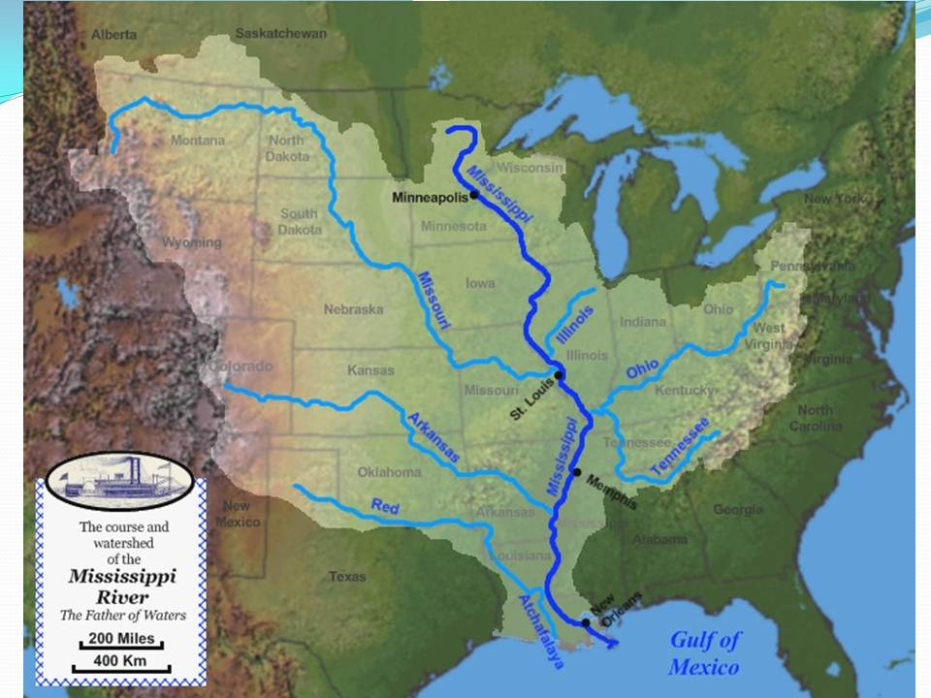
Get good at estimating
Classic problem – How much water comes out of the Mississippi River into the Gulf of Mexico each year?
Do it separately.
Write down your
calculations and
rationale.
Then we’ll
compare.
Notes:
What process did you use to do the estimation?
For this problem, typical techniques used include –
Try to estimate how fast the water comes out, and how wide the Mississippi river is at the Gulf.
Try to estimate how much rainfall comes into the basin shown, which empties into the Mississippi river.
Image from http://noladishu.blogspot.com/2011/11/blum-and-roberts-2009-drowning-of.html
According to http://www.mississippiriverresource.com/River/RiverFacts.php, at New Orleans the average water flow is 600,000 cubic feet per second.
Since there are 31.6 million seconds in a year, and 147 billion cubic feet in a cubic mile, that makes 129 cubic miles of water in a year.

Slide 4
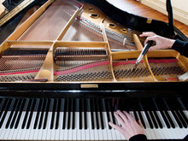
One more – same methodology
How many piano tuners work in Terre Haute?
  61,112 people live here.
  There are 2 easy-to-find piano teachers listed.
  Indiana State University has a music school with 4 listed piano faculty.
  Schools and churches
  all have pianos,
  including Rose-Hulman.
  Almost every child who takes
  piano lessons has a piano
  at home.
Notes:
Typical strategies for this problem include these:
Assume most pianos that are tuned regularly are for music students who live at home. So, how many people are taking piano lessons? This then fits in with guesses about how many pianos a full-time tuner can tune in a day, and how often the pianos are tuned.
Try to guess how many houses in town have pianos (like how many of your friends have pianos), and what percentage of these are actively played. Then consider the piano tuning rate, as above.
Try to guess the “institutional” pianos, like at schools and churches. Then try to estimate what percentage that is of the whole number. Then guess as above about the tuners.
Apply your own experience, if you have a piano, about how often you had it tuned. Then extrapolate from that.
Try to visualize how long the listing for Piano Tuners is in the yellow pages, or how many Google would find, then what percentage of the whole number advertise there?
The yellow pages on the web list 3, on 9-20-2014.
Image from http://www.thomdeanpianotuningandrepair.com

Slide 5
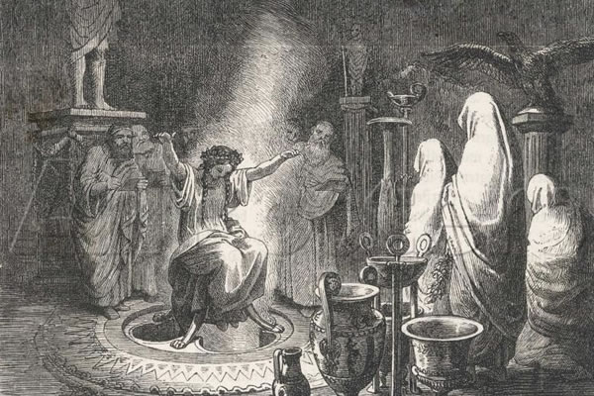
This is “Delphi” estimating
Experts separately give opinions and explain why.
Then they exchange information.
Goal usually is “convergence” over a few cycles.
  Like a consensus
Use when expert opinions
are needed to fill-in for a
lack of data.
Notes:
“Oracle of Delphi” image from http://commons.wikimedia.org/wiki/File:The_Oracle_of_Delphi_Entranced.jpg. See also http://en.wikipedia.org/wiki/Pythia.

Slide 6

How do estimates go wrong?
Step 1: Developers due to pressure
or optimism underestimate how long
things will take.
Step 2: Bad Problems
  Customer apply the pressure to make that
  schedule.
  People get anomic*
Step 3: We remember good things, forget bad
things – or the reverse.
  There’s definitely some ego involvement in how fast and error-free we can code!
  Kahneman’s studies – people only remember highlights of past experience. →
FeatureDevotion is part of this, too. How?
*Sociologist Emile Durkheim’s term.
Notes:
Why are developers always so optimistic? It’s a great question!
It turns out that estimation isn’t all cool and calculated, the way we’d like it to be. It’s emotional and political.
Anomie is “lack of the usual social or ethical standards in an individual or group.” Wikipedia entry for anomie is at http://en.wikipedia.org/wiki/Anomie
Image of bunnies and carrots from http://commons.wikimedia.org/wiki/File:Never_underestimate_or_overestimate.svg

Slide 7
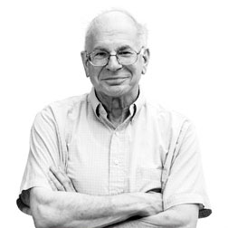
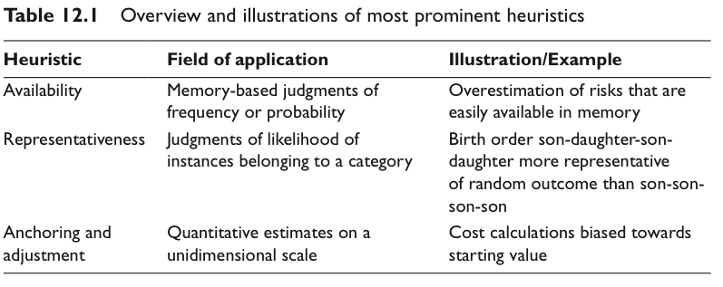
Kahneman and Tversky’s famous studies
Everyone thinks they remember and
estimate accurately, but science says otherwise:
Notes:
These are heuristics that people use to make estimates / judgments, according to Kahneman and Tversky’s 1970’s research studies.
“Availability” refers to the ease with which judgment cues are retrieved from memory. E.g., people erroneously think the letter “k” is more likely to be the first letter in words in the English language, than the third letter, because this information from their experience is easier to retrieve.
“Representativeness” judges the probability that a stimulus sample belongs to a category. People tend to ignore global constraints on estimates, raising the numbers illogically based on a single influence. In the example, the first birth order is an example of a group in which the odds of son or daughter are each 50%.
“Anchoring” is using an initial anchor, which is then adjusted in light of additional information. A person’s use of the additional information tends to be insufficient to overcome their initial bias.
Table from http://crisp.psi.uni-heidelberg.de/sites/default/files/vonSydow/Fiedler__von_Sydow_2015_Heuristic_and_biases_Beyond_Tversky__Kahneman_s_1974_In__Eysenck_Groome_Ch_12.pdf.
Photo of Daniel Kahneman from http://www.howtoacademy.com/psychology/thinking-fast-and-slow-2145?fromcat=24.

Slide 8
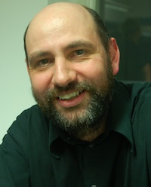
When should you estimate?
Martin Fowler has a specific answer:
Some Examples –
Allocation of resources.
  Organizations have a mostly fixed
  amount of money and people, and
  Usually there are too many worthwhile things to do.
Putting stories into the schedule.
  Points versus team velocity
Notes:
See p 10 of the pdf reading assignment from ThoughtWorks.
Martin Fowler’s web site is http://www.martinfowler.com. Has a lot of great tips about agile development, currently featuring continuous testing.

Slide 9
Why do it, exactly?
Fowler argues that you should never estimate unless you need the estimate to inform a particular decision.
For us, estimation is valuable when it helps you make a significant decision.
If they are going to affect significant decisions then go ahead and make the best estimates you can. Above all be wary of anyone who tells you they are always needed, or never needed. Any arguments about use of estimation always defer to the agile principle that you should decide what are the right techniques for your particular context.

Slide 10
“Points” or “ideal days”
Why are “Points” better than “days/hours”?
What did Anand Vishwanath recommend?
A relative comparison of stories
Both development and testing time
Use Fibonacci numbers?
Why is this better than using “ideal days”?
The real resulting days don’t verify estimates!
Points are a relative, abstract scale, like “utility” is used in economics to represent value.
Notes:
See p 9 of the pdf reading assignment from ThoughtWorks.

Slide 11
Spikes
A place where it’s hard to estimate points.
Can figure backwards –
  It’s worth a week for half the team.
  So, how many points is that?
Can change later estimates!
Usually the spike is “throwaway” code.
Notes:
See pp 10-11 of the pdf reading assignment from ThoughtWorks.

Slide 12
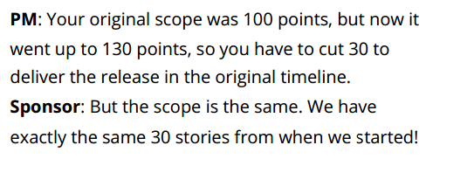
Now Points are Bad Too!
Stories represent 3 things:
Feature/Function
Richness/usability/depth
Technical complexity
Notes:
JK, the Agile coach (p 12 of the ThoughtWorks article) doesn’t even like doing “estimates,” because people want to hold you to these estimates. He likes calling the points exercise “sizing”.
Juliano (p 16) really dislikes points!

Slide 13
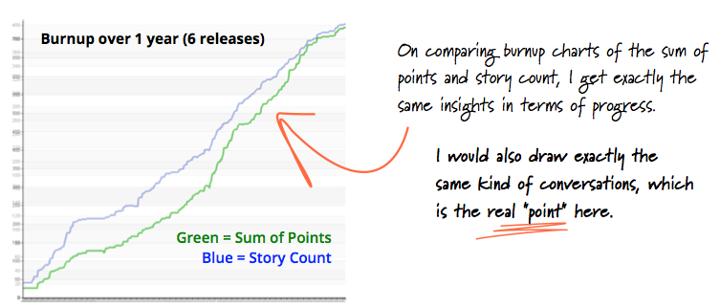
Juliano’s burn-up picture
Notes:
From the ThoughtWorks article, p 16.

Slide 14
Why are we doing this, again?
The major problems they want to solve by estimation are:
Derive an estimated scale for a new bucket of stories to help plan future releases.
Provide an estimated eﬀort for each story to help the business prioritize better (from a ROI perspective, value vs. cost)
Synchronize the derived understanding of the story and its context across all distributed locations.
Gain conﬁdence and build customer trust by fully understanding the business/ technical context before commitment to build.
Notes:
See Malcolm’s “bucket theory,” pp 13-14.

Slide 15

People are the fragile part
Reflect on differences and Alistair
Cockburn’s discussion of the effect
of process…
See IEEE Computer, Nov 2001,http://www.uml.org.cn/softwareprocess/pdf/IEEEArticle2Final2.pdf
Agile puts more emphasis on people.
A little more process costs you a lot.
Individual strengths are crucial.
People are highly variable and non-linear, with unique success and failure modes.
Notes:
See also http://alistair.cockburn.us/Characterizing+people+as+non-linear,+first-order+components+in+software+development/v/slim
Image – Cockburn demos how people can be non-linear. From http://alistair.cockburn.us

Slide 16
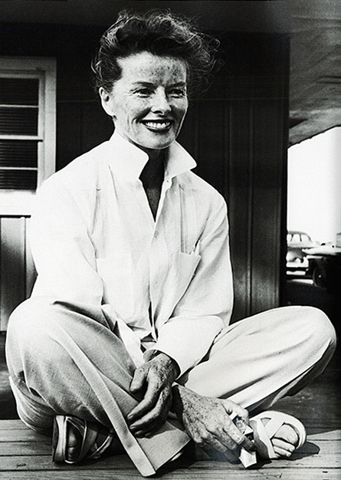
Cockburn’s “Oath of Non-Allegiance”
I promise not to exclude from consideration any idea based on its source, but to consider ideas across schools and heritages in order to find the ones that best suit the current situation.
Or,
If you obey all the rules,
you miss all the fun.
- Katharine Hepburn
Notes:
In estimating software, it’s very useful to have a wide range of people in the room. This is similar to the situation for brainstorming. At Ideo, famous for product innovation, they used to have a guy who crawled down a ladder from the ceiling, to participate. (See http://www.ideo.com, for more info about them.)
http://alistair.cockburn.us/oath+of+non-allegiance
Hepburn image from http://dressme-styleicon.blogspot.com/2013/03/katharine-hepburn.html

Slide 17
Additions – from your questions
Parametric estimation
Velocity and acceleration
Do a group envisioning activity
How to handle customers resistant to agile

Slide 18
Additions – Parametric estimation
This is an extension of “using historical data to estimate.”
Idea is like this:
  What are the closest things we’ve done to this new thing we have to estimate?
    Except maybe for the size…
    Then use relative sizes as a multiplier for your guess.
There’s a lot more to it!
  See next slide for one example. →

Slide 19
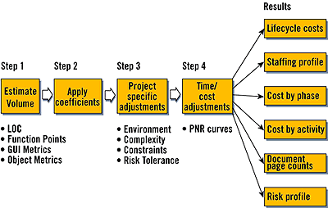
Additions – Parametric estimation, cntd
“n a typical cycle, you first estimate volume using any of several metrics. Then, feed these numbers to coefficient-driven equations to create a baseline estimate. Adjust this estimate first to your specific project, and then for inefficiencies caused by schedule pressure. Now you can output cost, staffing and risk breakdowns.”
Notes:
From http://www.drdobbs.com/estimating-internet-development/184414639, which also is a good starting resource for this.

Slide 20
Additions – Velocity and acceleration
In agile developments using points, you decide how long things will take based on experience.
  Can start by using previous projects.
  Later, you have a basis in the current project.
  “How do points equate to expected time?”
    Like points per iteration (or stories per iteration).
  This leads to guesses about both:
    How much can we get done in the next sprint? And,
    How long will the whole project take?
  That’s your “velocity.”
  Acceleration – see next slide. →

Slide 21
Additions – Velocity and acceleration, cntd
What’s acceleration?
It’s changes in the velocity, just like in physics.
Like, “In the last project, we did 5 stories per iteration. In this project, we’re averaging 6 so far. So, we’ve accelerated by 1 story per iteration.”
In both these measures, clearly the project, team size, and team composition play a role.

Slide 22
Additions – Group envisioning activity
(We did one the first week – the bear repellant!}
We’ll do this Friday, April 10. Make that April 17!
  We’ll pick a product topic, break into teams.
  We’ll design a “product vision box,” like on Highsmith’s pp 96-7.
    Product name, a graphic.
    3-4 key bullet points on the front that “sell” the product.
    A detailed feature description on the back, and operating requirements.
  See example, next page. →

Slide 23
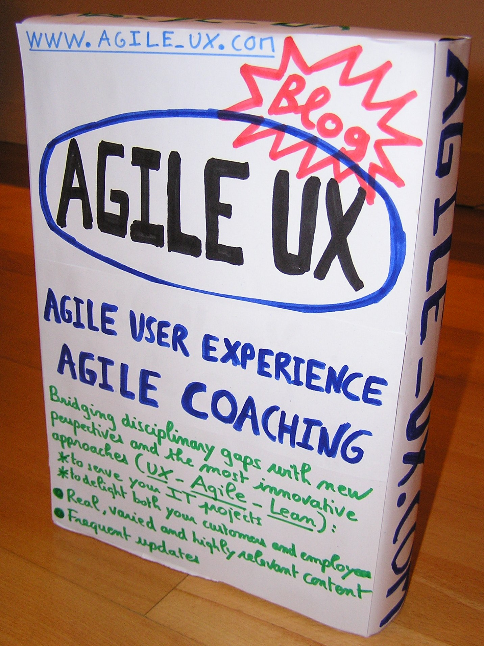
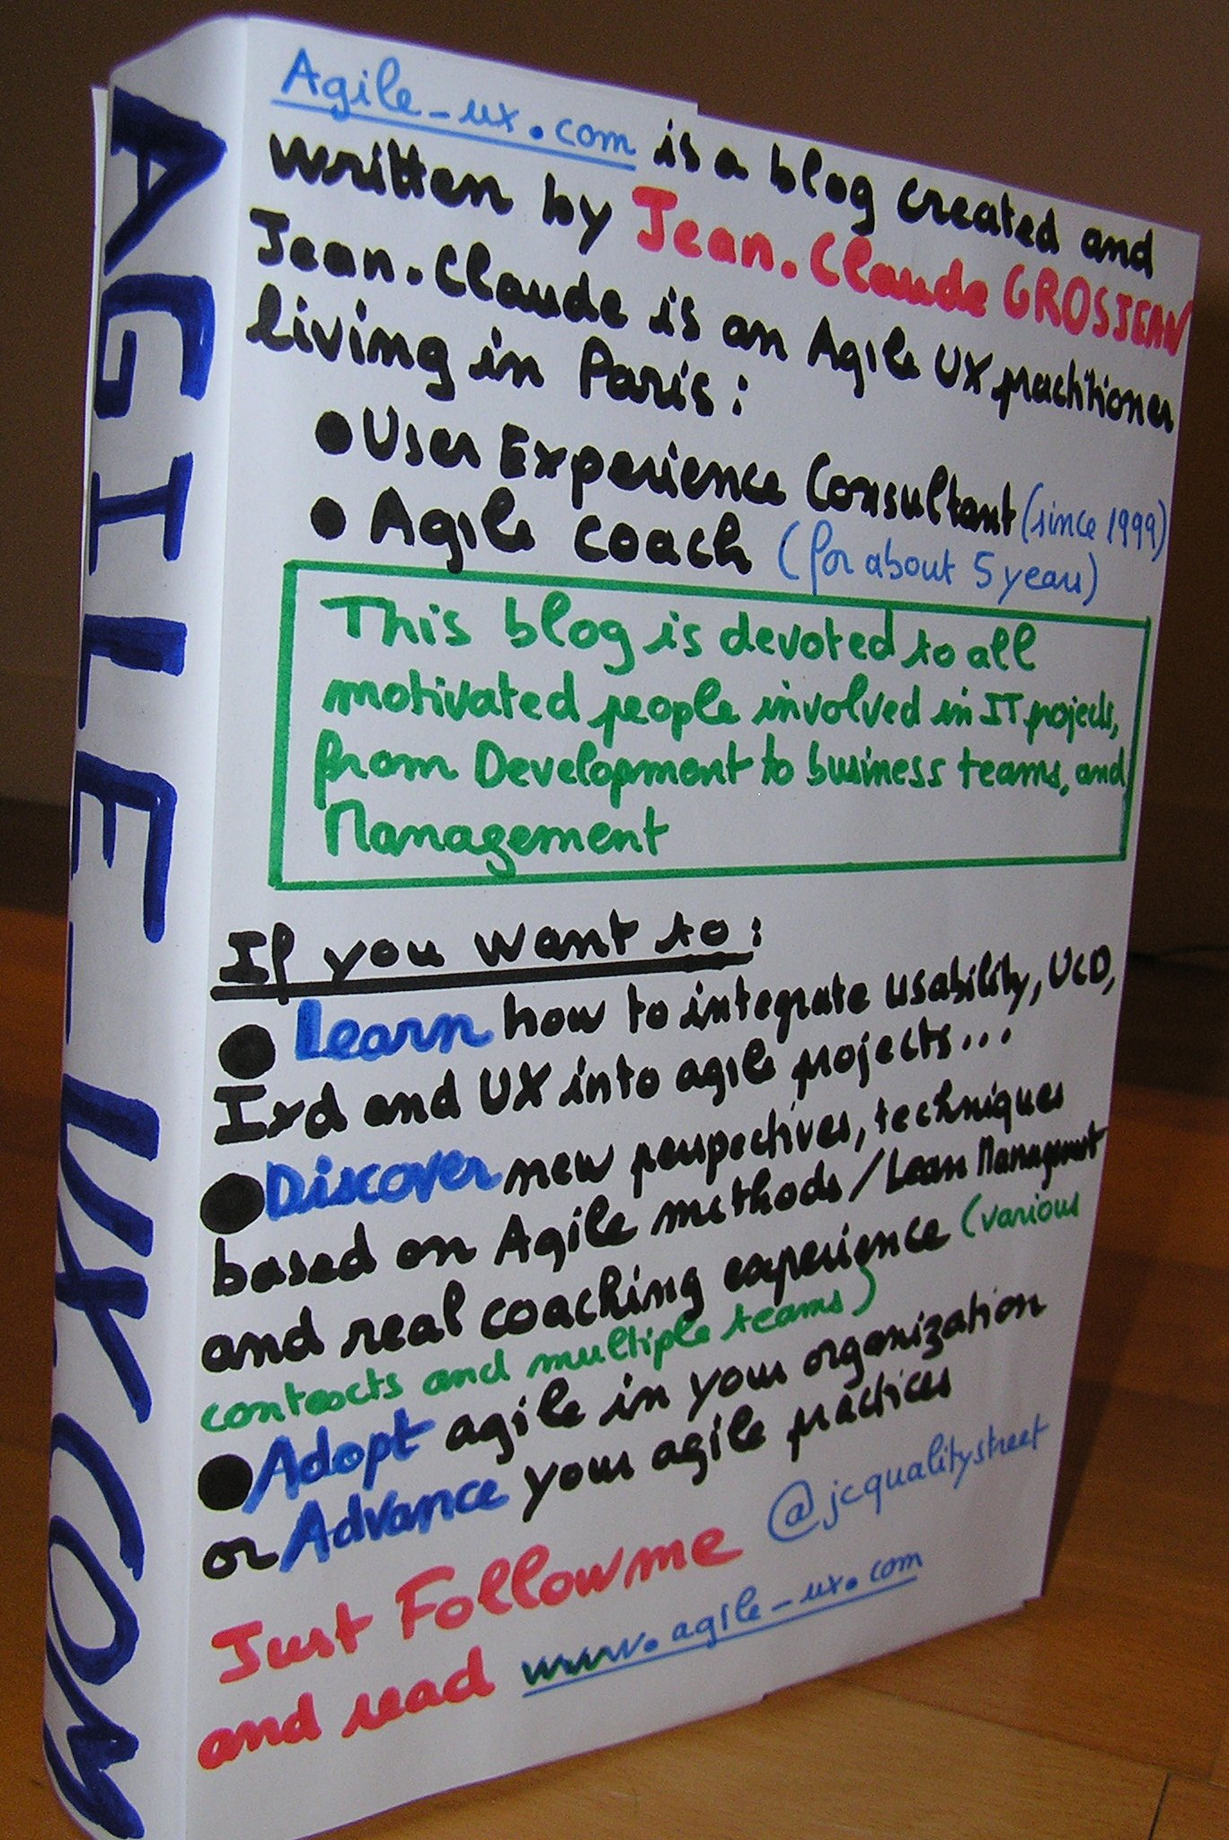
Additions – Group envisioning activity, cntd - Example
Notes:
From http://www.agile-ux.com/2011/03/04/a-day-in-life-of-an-agileux-practitioner-vision/.

Slide 24
Additions – Handling customers who are resistant to agile
They already have a process, which they’ve used successfully.
It’s not agile.
They expect the same “process deliverables” as they’ve always gotten, during development.
  Like detailed estimates, EVM reports, risk reports, and documents at completion of stages.
  Typical strategy – Try to wean them off these a bit at a time, gaining their cooperation for Agile.
  And deliver the benefits of Agile to create enthusiasm.

